Slide 1
Intelligent Routing Algorithm in Wireless Sensor Networks

Slide 2
Introduction
Wireless Sensor Networks (WSNs) are extensively used to monitor physical or environmental conditions
An energy efficient variant of Q-routing protocol which uses Reinforcement Learning to increase the average lifetime of the network is applied
We implemented a model which considers the energy as well as the load of the neighboring nodes before forwarding a packet

Slide 3
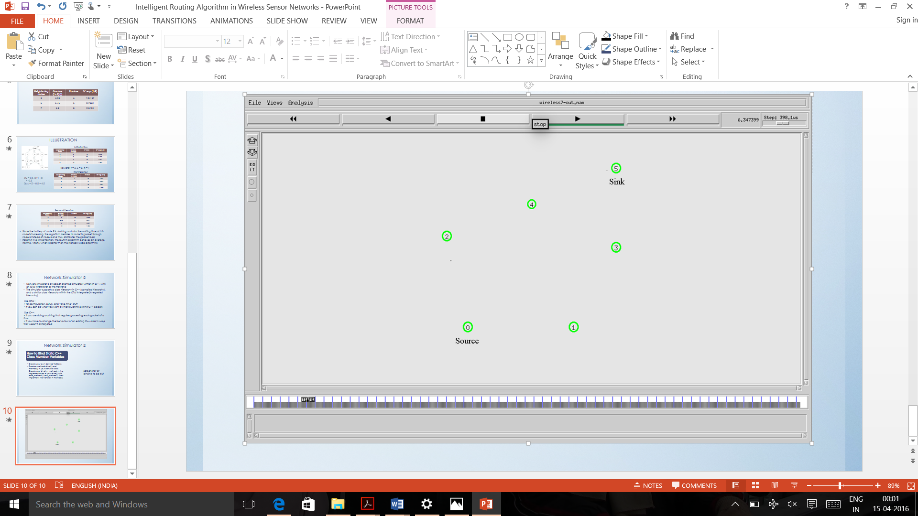
Topology
(450,450)
(250,370)
(50,300)
(450,275)
(100,100)
(350,100)

Slide 4
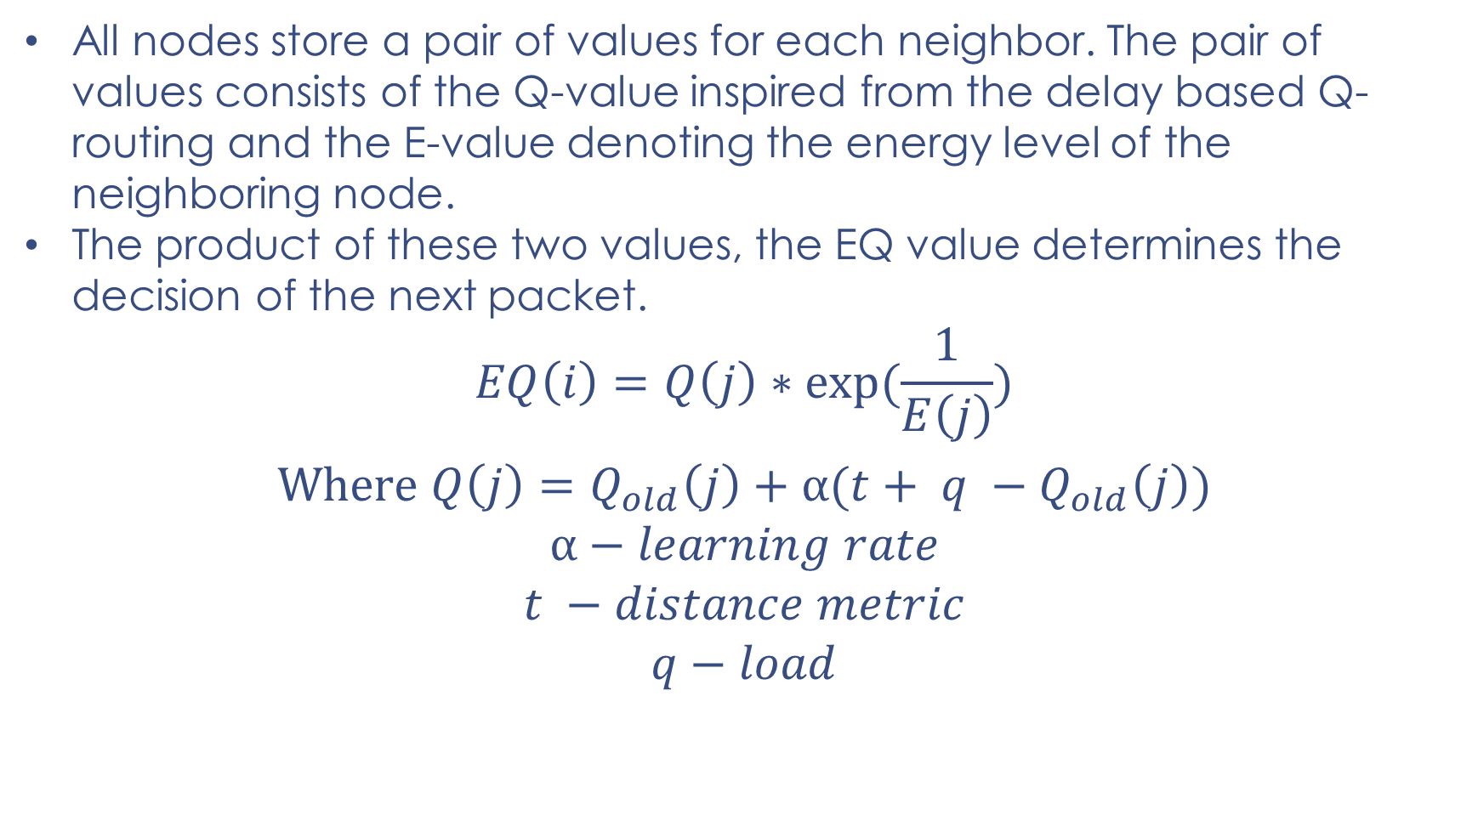
ENERGY EFFICIENT Q- ROUTING ALGORITHM
All nodes store a pair of values for each neighbor. The pair of values consists of the Q-value inspired from the delay based Q-routing and the E-value denoting the energy level of the neighboring node.
The product of these two values, the EQ value determines the decision of the next packet.
$$EQ\left(i\right)=Q\left(j\right)∗exp⁡(\frac{1}{E\left(j\right)})$$
$$Where Q\left(j\right)=Q_{old}\left(j\right)+α(t+ q −Q_{old}\left(j\right))$$
$$α−learning rate$$
$$t −distance metric$$
$$q−load$$

Slide 5
Network Simulator 2
Network simulator is an object oriented simulator, written in C++, with an OTcl interpreter as the frontend
The simulator supports a class hierarchy in C++ (compiled hierarchy), and a similar class hierarchy within the OTcl interpreter(interpreted hierarchy)
Use OTcl :
• for configuration, setup, and “one-time” stuff
• if you can do what you want by manipulating existing C++ objects
Use C++:
• if you are doing anything that requires processing each packet of a flow
• if you have to change the behaviour of an existing C++ class in ways that weren’t anticipated

Slide 6
Phase 1:
Start
Send_route_discovery()
Recv_route_disc()
Routing Table
add_entry()
Rtable initialized

Slide 7
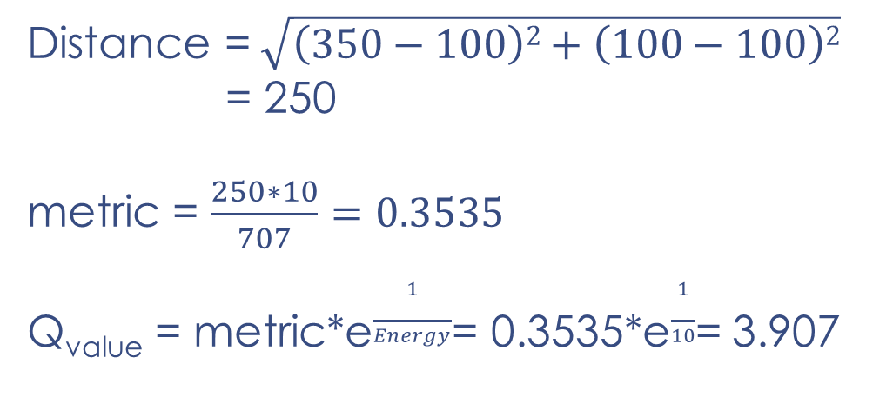
Computation
Distance =$\sqrt{\left(350−100\right)2+\left(100−100\right)2}$
= 250
metric = $\frac{250∗10}{707}=0.3535$
Q_{value} = metric*e$\frac{1}{Energy}$= 0.3535*e$\frac{1}{10}$= 3.907
0
1
(100,100)
(350,100)

Slide 8
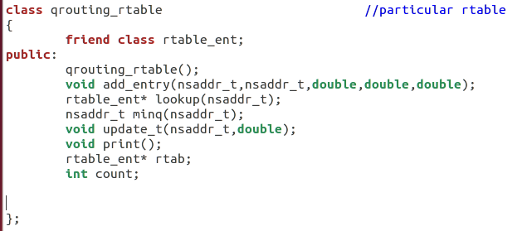
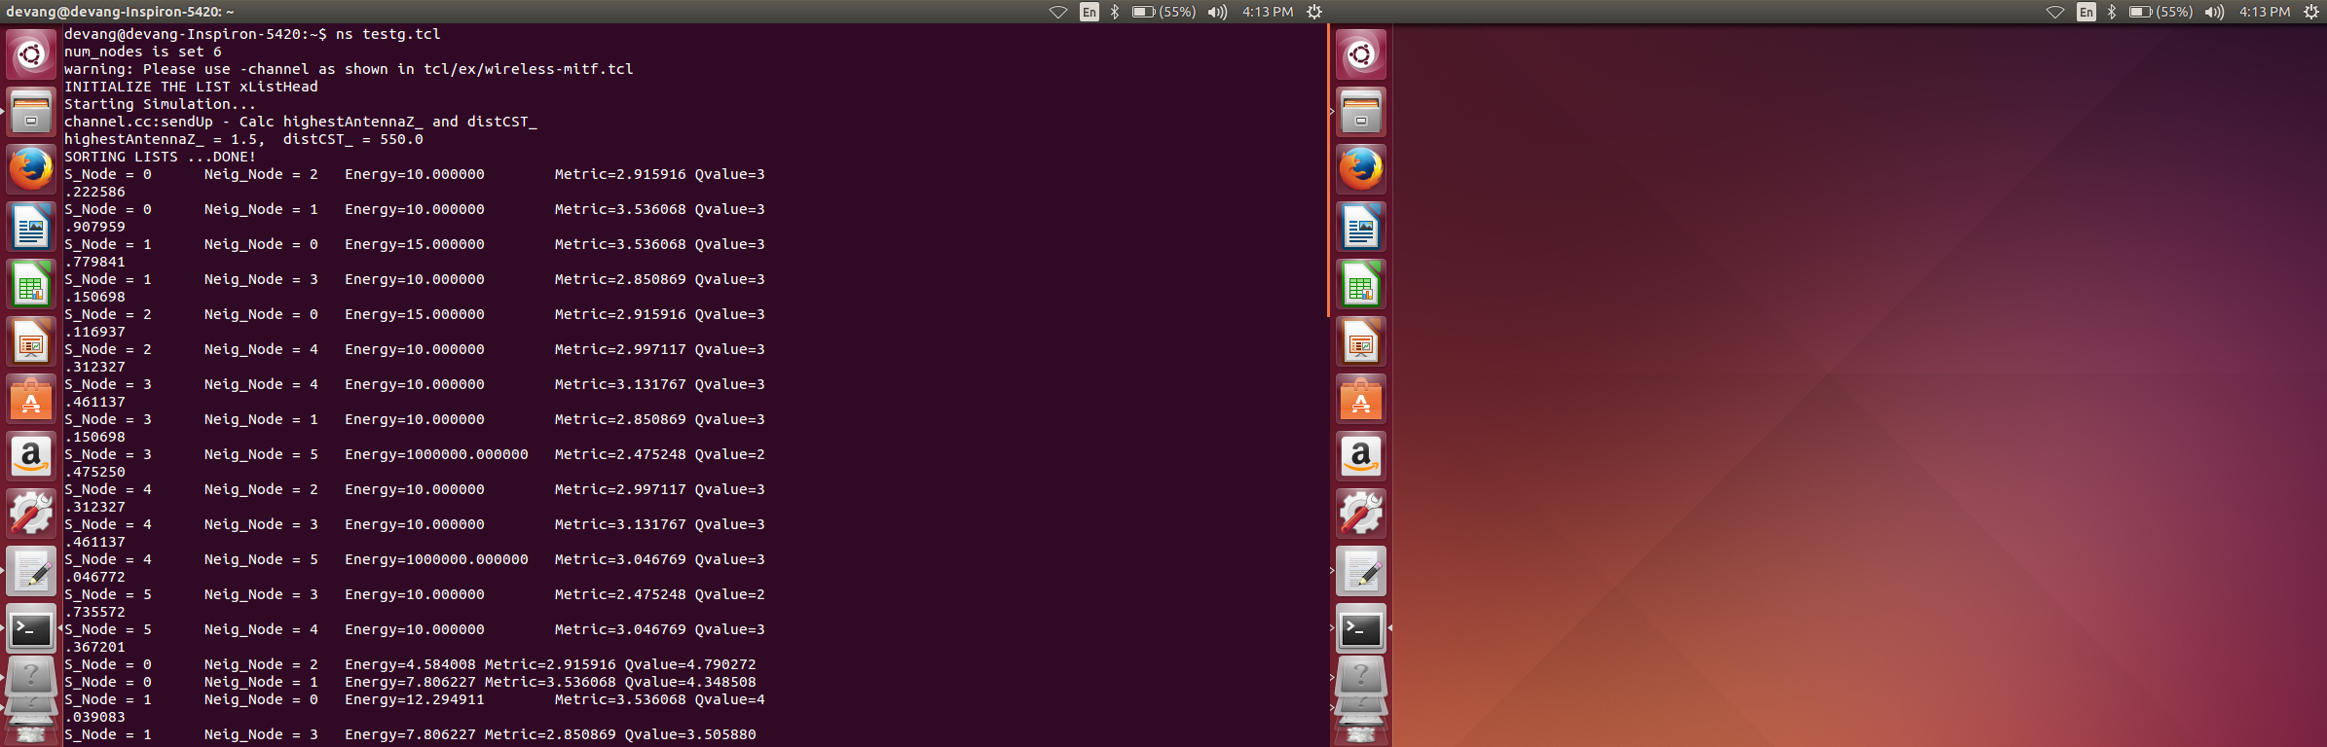
Routing Table code
Initial Routing Table for each node

Slide 9
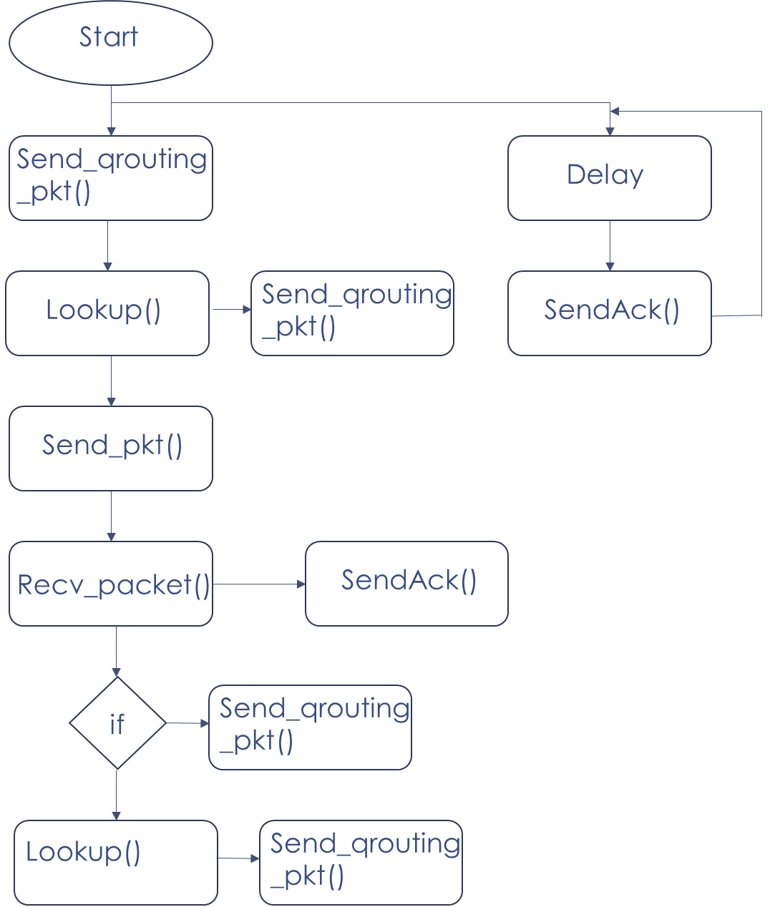
Phase 2:

Slide 10
Hybrid Methodology
Broadcast
Unicast
Advantage
Information of all neighbours
Disadvantage
All nodes remain active
More amount of energy drains
Advantage
Only two node remains active
Lesser amount energy drains
Disadvantage
Partial information is achieved

Slide 11
Implementation

Slide 12
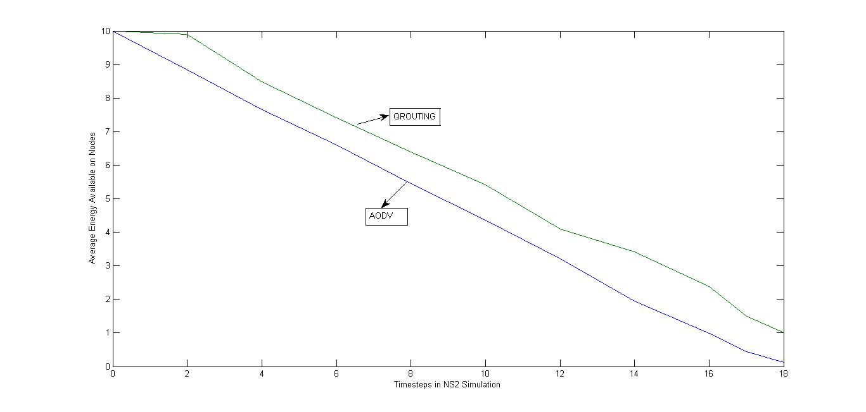
Results and Discussions
Comparison Graph for Lifetime of Topology

Slide 13
Conclusion and Future Scope
We discern that the average lifetime of the network increases when an adaptive algorithm is used.
Considering the load of the neighboring nodes before sending packets helps us improve average lifetime of the network
This project can also be extended by finding ways in which energy can be transferred from one node to another through some medium
Energy harvesting techniques like obtaining energy through solar, vibration, wind can be implemented

Slide 14
Thank You!
Devang Jhaveri
Miti Jhaveri
Jehan Kandawalla

